Slide 1

Prototyping AI Agents with GitHub Models (and Python!)
Pamela Fox
Python Cloud Advocate @ Microsoft
https://www.linkedin.com/in/pamela-s-fox/
http://www.pamelafox.org/
In partnership with

Slide 2
GitHub Models

Slide 3
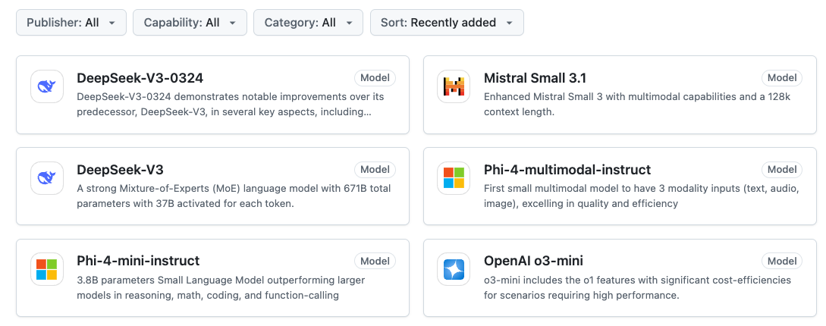
GitHub Models
Free, powerful generative AI models - only GitHub account is needed!
45 models
and counting!
https://github.com/marketplace/models

Slide 4
So many models to pick from!
Kind | Examples
Large Language Models | OpenAI gpt-4o, Cohere Command R+, Mistral Large, Jamba 1.5 Large
Small Language Models | Phi-3-mini-instruct, Llama-3.1-8B
🧠 Reasoning language models | OpenAI o1, o3-mini, DeepSeek-R1
🖼️ Multimodal language models | OpenAI GPT-4o, Llama-3.2-vision, Mistral Small, Phi-3.5-vision
💻 Code generation language models | Codestral
🔎 Embedding models | Cohere Embed v3, OpenAI text-embedding-3
https://github.com/marketplace/models

Slide 5
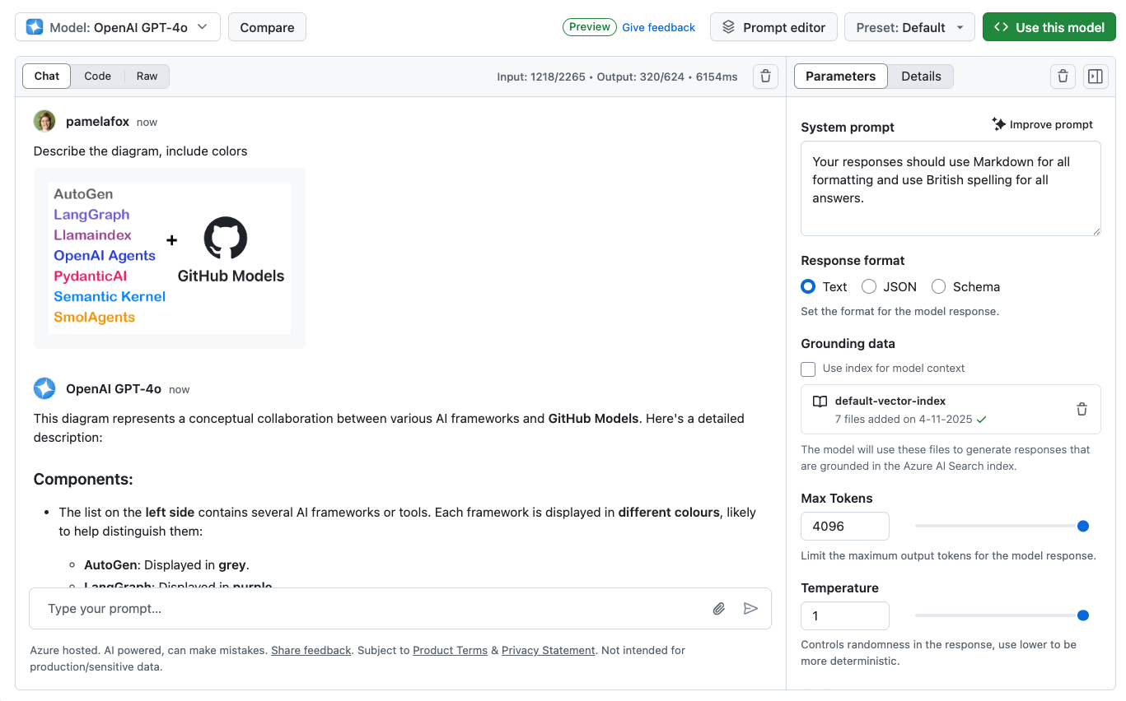
Getting started with GitHub Models
Open the playground for a model, send questions, and test parameters:
Select
model
Customize
parameters

Slide 6
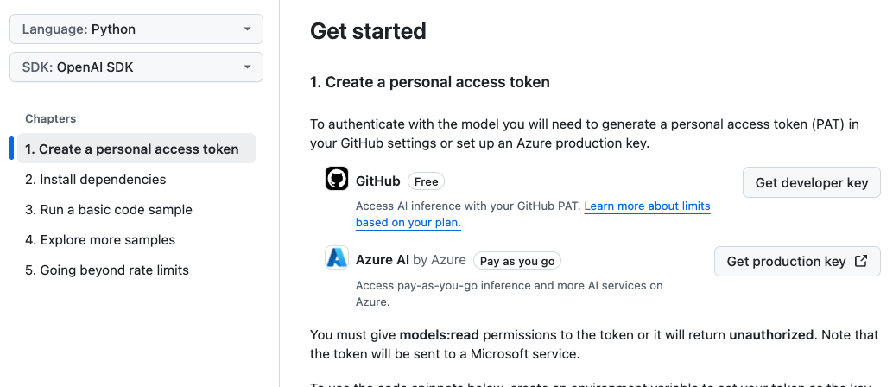
Coding with GitHub Models
Select "Use this model" to get sample code for each model:
Select language
Select SDK

Slide 7
GitHub Models + Python 🐍

Slide 8
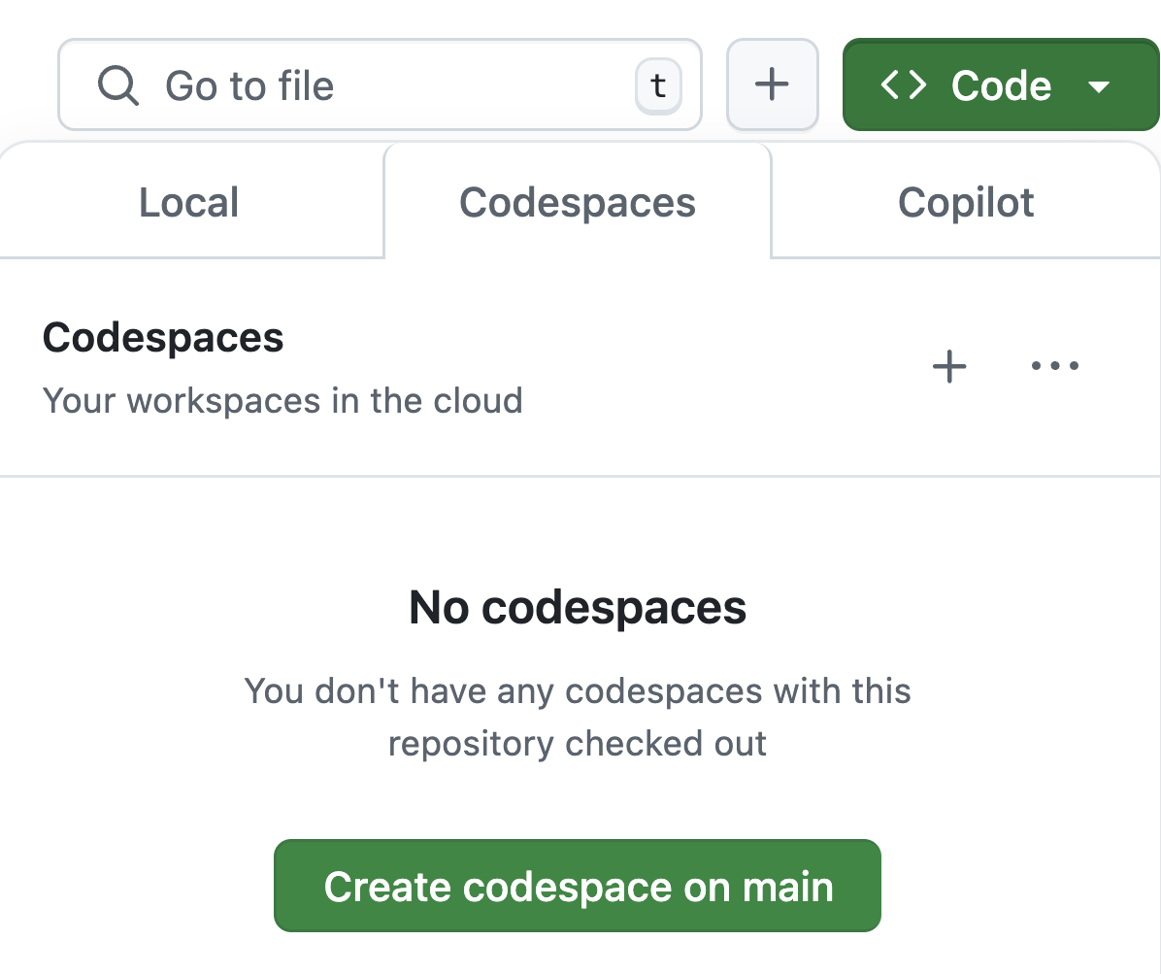
Want to follow along?
1. Open this GitHub repository:
https://github.com/Azure-Samples/python-ai-agent-frameworks-demos
2. Use "Code" button to create a GitHub Codespace:
3. Find all code samples in examples/ folder

Slide 9
Using the Azure AI inference package
pip install azure-ai-inference
from azure.ai.inference import ChatCompletionsClient
from azure.ai.inference.models import SystemMessage, UserMessage
from azure.core.credentials import AzureKeyCredential
client = ChatCompletionsClient(
endpoint="https://models.inference.ai.azure.com",
credential=AzureKeyCredential(os.environ["GITHUB_TOKEN"]),
)
response = client.complete(
messages=[
SystemMessage(content="You are a helpful assistant."),
UserMessage(content="What is the capital of France?"),
],
model= "gpt-4o")
Full example: azureai_githubmodels.py

Slide 10
Where does GITHUB_TOKEN come from?
In GitHub Codespaces:
GITHUB_TOKEN is automatically set in the environment upon startup.
In local environments:
Generate a Personal Access Token from your GitHub account
Export as environment variable or store in a .env file
Generate a new PAT when old PATs expires
https://aka.ms/githubmodels/pat

Slide 11
Using the official OpenAI package
pip install openai
from openai import OpenAI
client = OpenAI(
base_url="https://models.inference.ai.azure.com",
api_key=os.environ["GITHUB_TOKEN"],
)
response = client.chat.completions.create(
messages=[{
"role": "system",
"content": "You are a helpful assistant.",
},{
"role": "user",
"content": "What is the capital of France?",
}],
model="gpt-4o"
)
Full example: openai_githubmodels.py

Slide 12
Using OpenAI function calling ("Tools")
tools = [{
"type": "function",
"function": {
"name": "lookup_weather",
"description": "Lookup the weather for a given city name or zip code.",
"parameters": {
"type": "object",
"properties": {
"city_name": {
"type": "string",
"description": "The city name",
},
"zip_code": {"type": "string",
"description": "The zip code"
}}}}}]
response = client.chat.completions.create(
model="gpt-4o",
messages=[
{"role": "system",
"content": "You're a weather chatbot."},
{"role": "user",
"content": "whats the weather in nyc?"},
],
tools=tools,
)
Full example: openai_functioncalling.py
Learn more: https://platform.openai.com/docs/guides/function-calling

Slide 13
Python AI Agent frameworks 🤖

Slide 14
Python AI agent frameworks
We'll be experimenting with these frameworks today:
Framework | Description
openai-agents | A lightweight framework based on the openai swarm package and support for multiple providers.
pydantic-ai | A flexible framework designed for type safety and observability, from the creators of Pydantic.
autogen | A framework from Microsoft Research that showcases agentic orchestration patterns from research.
semantic-kernel | A framework from Microsoft for production apps that brings in features from autogen and integrates with Azure.

Slide 15
How to use GitHub Models with any framework?
Once the OpenAI Chat Completions API became a defacto standard supported by many non-OpenAI LLM API providers, Python AI packages added support for OpenAI-like API endpoints.
GitHub Models provides OpenAI-compatible endpoints for chat completion models, even for the non-OpenAI models.
Therefore, any Python AI framework that supports OpenAI-like API endpoints can be used with GitHub Models as well.
General strategy:
Check the documentation to find the OpenAI support for the framework.
Customize the base URL and key to match GitHub Models.
https://aka.ms/agentshack/githubmodels-agentframeworks

Slide 16
openai-agents: Basic example
Connect to GitHub Models by passing an openai.AsyncOpenAI object directly:
import agents
import openai
client = openai.AsyncOpenAI(
base_url="https://models.inference.ai.azure.com",
api_key=os.environ["GITHUB_TOKEN"])
model = agents.OpenAIChatCompletionsModel(
model="gpt-4o", openai_client=client)
agent = agents.Agent(
name="Spanish Tutor",
instructions="You are a Spanish tutor, only respond in Spanish!",
model=model
)
Full example: openai_agents_basic.py

Slide 17
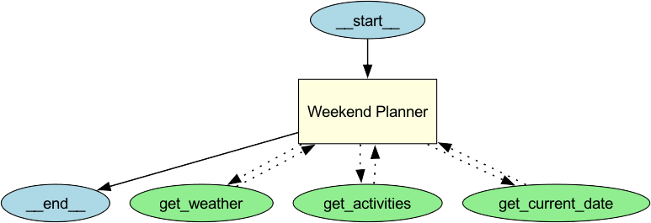
Agent architectures: Single agent with tools
The agent can decide which tool to use and what arguments to send.
LLM
Tool A
Tool B
Tool C
General architecture
Weekend planner example

Slide 18
openai-agents: Single agent with tools
Define new tools using @function_tool decorator and tools argument:
@function_tool
def get_activities(city: str, date: str) -> list:
return [
{"name": "Hiking", "location": city},
{"name": "Beach", "location": city},
{"name": "Museum", "location": city},
]
# more tools
agent = Agent(
name="Weekend Planner",
instructions="You help users plan their weekends.",
tools=[get_activities, get_weather, get_current_date],
model=model)
Full example: openai_agents_tools.py

Slide 19
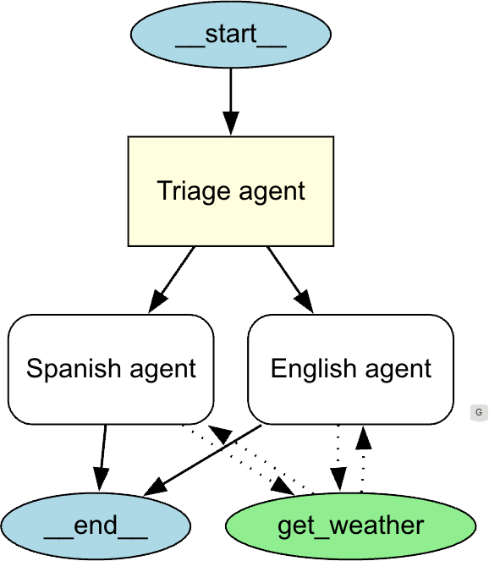
Agent architectures: Supervisor agent with sub-agents
The supervisor agent decides which specialist agents should handle a task.
Each agent may still have associated tools to call.
Supervisor Agent
Agent A
Agent B
General architecture
Multilingual weather example

Slide 20
openai-agents: Supervisor agent with handoffs
Use handoffs to indicate when an agent can delegate to other agents:
spanish_agent = Agent(
name="Spanish agent", instructions="You only speak Spanish.",
tools=[get_weather],
model=OpenAIChatCompletionsModel(model=MODEL_NAME, openai_client=client))
english_agent = Agent(
name="English agent", instructions="You only speak English",
tools=[get_weather],
model=OpenAIChatCompletionsModel(model=MODEL_NAME, openai_client=client))
triage_agent = Agent(
name="Triage agent",
instructions="Handoff to appropriate agent based on language of the request.",
handoffs=[spanish_agent, english_agent],
model=OpenAIChatCompletionsModel(model=MODEL_NAME, openai_client=client))
Full example: openai_agents_handoffs.py

Slide 21
openai-agents: When to use?
Features:
Tools
Handoffs
Guardrails
MCP support
Tracing
You might choose openai-agents if...
You are already using the OpenAI SDK, don't want to make large code changes, but do want to organize your code around agents instead of chat completions
You want the built-in tracing feature with OpenAI.com / supported tracing providers
You were previously using swarm package
The framework is a good fit for you 🧩
Learn more:
https://openai.github.io/openai-agents-python

Slide 22
autogen
Connect to GitHub Models by using its wrappers of OpenAI clients:
import autogen_ext.models.openai
import autogen_agentchat.agents
client = autogen_ext.models.openai.OpenAIChatCompletionClient(
model="gpt-4o", api_key=os.environ["GITHUB_TOKEN"],
base_url="https://models.inference.ai.azure.com"
)
agent = autogen_agentchat.agents.AssistantAgent(
"spanish_tutor",
system_message="You are a Spanish tutor. ONLY respond in Spanish.",
model_client=client,
)
Full example: autogen_basic.py

Slide 23
Agent architectures: Round Robin Group Chat
Each agent broadcasts to each other agent and take turns responding,
until a termination condition stops the chat.
Agent A
Agent B
TERMINATION
Agent B
Agent C
https://microsoft.github.io/autogen/stable/user-guide/agentchat-user-guide/tutorial/teams.html

Slide 24
Agent architectures: Round Robin with single agent
To get an agent to run multiple times (to call on multiple tools) in Autogen,
use a Round Robin group chat with only that agent.
Tool 1
Agent A
Tool 2
TERMINATION
Terminate when the agent finally responds with a text message.
https://microsoft.github.io/autogen/stable/user-guide/agentchat-user-guide/tutorial/agents.html

Slide 25
autogen: Round robin with single agent
Define the agent with tools, create a RoundRobinGroupChat for that agent:
agent = AssistantAgent(
"weekend_planner",
model_client=client,
tools=[get_weather, get_activities, get_current_date],
system_message="You help users plan their weekends.")
team = RoundRobinGroupChat([agent],
termination_condition=TextMessageTermination(agent.name))
async for task_result in team.run_stream(
task="what can I do for funzies this weekend in Seattle?"):
logger.debug(task_result)
print(task_result.messages[-1].content)
Full example: autogen_tools.py

Slide 26
Agent architectures: Magentic One
Magentic One orchestrator
Task ledger
Given or verified facts
Facts to look up
Facts to derive
Task plan
Progress ledger
Task complete?
Is progress being made?
What's next agent?
Next agent instruction
Task complete?
Yes
Final result
No
Yes
Stall
count
> 2
No
Progress being
made?
Yes
Agent A
Agent B
Agent C
https://microsoft.github.io/autogen/stable/user-guide/agentchat-user-guide/magentic-one.html

Slide 27
autogen: Magentic one with multiple agents
Create a MagenticOneGroupChat with agents list and termination condition:
local_agent = AssistantAgent(...)
language_agent = AssistantAgent(...)
travel_summary_agent = AssistantAgent(
"travel_summary_agent",
model_client=client,
description="A helpful assistant that can summarize the travel plan.",
system_message="You take in suggestions and advice and provide a detailed final travel plan. When the plan is complete and all perspectives are integrated, respond with TERMINATE.",
)
termination = group_chat = MagenticOneGroupChat(
[local_agent, language_agent, travel_summary_agent],
termination_condition=TextMentionTermination("TERMINATE"),
model_client=client,
)
print(task_result.messages[-1].content)
Full example: autogen_magenticone.py

Slide 28
autogen: When to use?
Features:
Tools
Termination conditions
Handoffs to agents/users
Orchesterators:
RoundRobin
SelectorGroupChat
Swarm
MagenticOne
You might choose autogen if...
You want to use a multi-agent orchestrator that's only available in autogen
You need human-in-the-loop for a multi-agent orchestration
You're comfortable with a more quickly changing API
The framework is a good fit for you 🧩
Learn more:
https://microsoft.github.io/autogen/

Slide 29
pydantic-ai
Connect to GitHub Models by passing openai.AsyncOpenAI client in the provider:
import openai
import pydantic_ai
import pydantic_ai.models.openai
client = openai.AsyncOpenAI(
api_key=os.environ["GITHUB_TOKEN"],
base_url="https://models.inference.ai.azure.com")
model = pydantic_ai.models.openai.OpenAIModel(
"gpt-4o",
provider=OpenAIProvider(openai_client=client))
agent: pydantic_ai.Agent[None, str] = Agent(
model,
system_prompt="You are a Spanish tutor. ONLY respond in Spanish.",
result_type=str)
Full example: pydanticai_basic.py

Slide 30
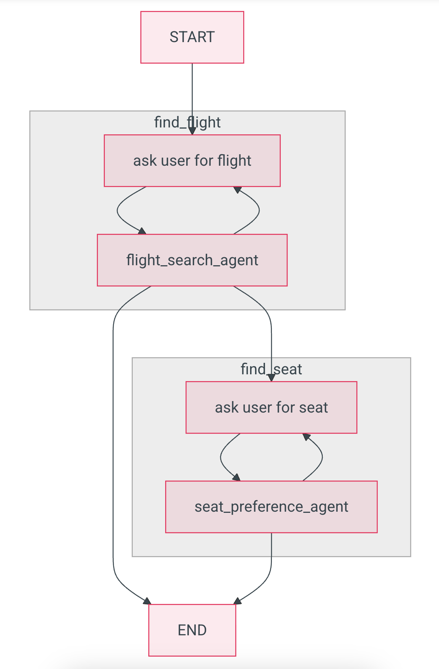
Agent architecture: Programmatic agent handoff
Agent A
Needs retry?
Acceptable result
Next step needed?
Agent B
Needs retry?
Acceptable result
TERMINATE
Flight planner example

Slide 31
pydantic-ai: Programmatic agent handoff
opt_flight_details = await find_flight()
if opt_flight_details is not None:
seat_preference = await find_seat()
async def find_flight() -> Flight | None:
for _ in range(3):
prompt = Prompt.ask("Where would you like to fly?")
result = await flight_search_agent.run(
prompt,
message_history=message_history)
if isinstance(result.data, Flight):
return result.data
else:
message_history = result.all_messages(
result_tool_return_content="Try again.")
async def find_seat() -> Seat:
message_history = None
while True:
answer = Prompt.ask(
"What seat would you like?")
result = await seat_agent.run(
answer,
message_history=message_history)
if isinstance(result.data, Seat):
return result.data
else:
print("Didnt understand. Try again.")
message_history = result.all_messages()
Full example: pydanticai_multiagent.py

Slide 32
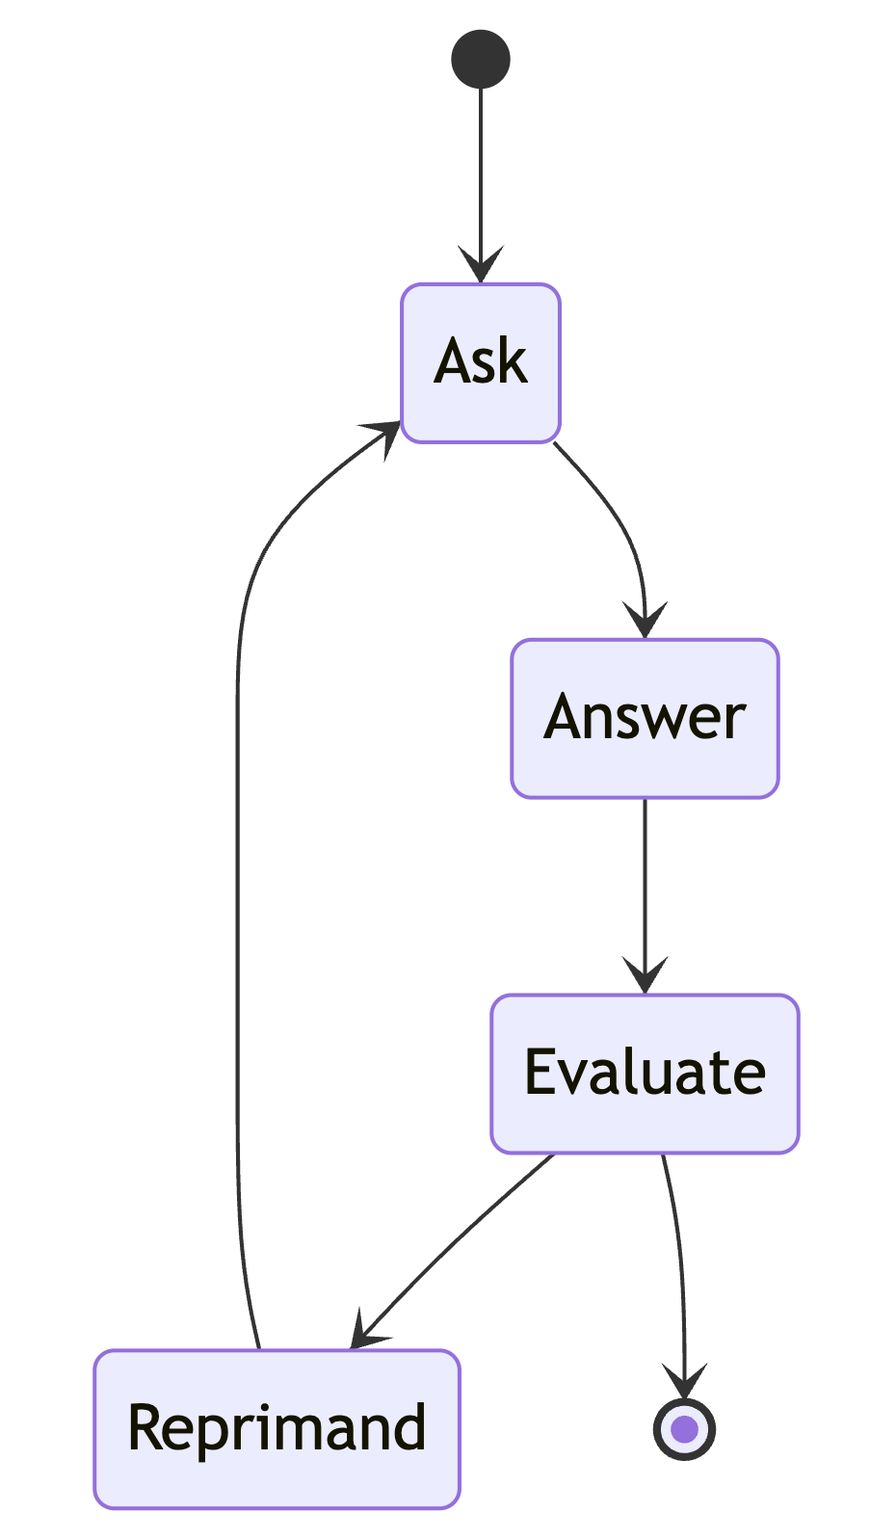
Agent architecture: Graph
A graph can be laid out many ways, as long as it ENDs.
START
Node
Node
Node
Node
Node
END
Q&A example

Slide 33
pydantic-ai: Graph architecture
Define BaseNodes that call Agents and run the Graph with a state object:
@dataclass
class Ask(BaseNode[QuestionState]):
async def run(self, ctx) -> Answer:
result = await ask_agent.run(
'Ask a simple question with a single correct answer.',
message_history=ctx.state.ask_agent_messages)
ctx.state.ask_agent_messages += result.all_messages()
ctx.state.question = result.data
return Answer(result.data)
question_graph = Graph(nodes=(Ask, Answer, Evaluate, Reprimand),
state_type=QuestionState)
start_node = Ask()
end = await question_graph.run(start_node, state=QuestionState())
Full example: pydanticai_graph.py

Slide 34
pydantic-ai
Features:
MCP support
Graph architecture
Structured outputs
Tracing
Evaluation
You might choose pydantic-ai if...
You want strongly typed agents
You already use Pydantic models heavily in your codebase (for FastAPI or otherwise)
You are a LogFire user
You don't mind rapidly changing frameworks
The framework is a good fit for you 🧩
Learn more:
https://ai.pydantic.dev/

Slide 35
semantic-kernel
Configure by passing an openai.AsyncOpenAI object to the connector:
import openai
import semantic_kernel.connectors.ai.open_ai
import semantic_kernel.agents
chat_client = openai.AsyncOpenAI(
api_key=os.environ["GITHUB_TOKEN"],
base_url="https://models.inference.ai.azure.com")
chat = semantic_kernel.connectors.ai.open_ai.OpenAIChatCompletion(
ai_model_id="gpt-4o",
async_client=chat_client)
agent = semantic_kernel.agents.ChatCompletionAgent(
name="spanish_tutor",
instructions="You are a Spanish tutor. ONLY respond in Spanish.",
service=chat)
Full example: semantickernel_basic.py

Slide 36
Agent architecture: Agent group chat
Similar to a supervisor agent architecture, using function calling for
agent delegation and chat termination.
Agent B
response
Agent group chat
response
Agent A
Selection function
chat history
chat history
Termination
function
chat history
END

Slide 37
semantic-kernel: Agent group caht
Define agents, define selection and termination functions, pass to AgentGroupChat:
chat = AgentGroupChat(
agents=[agent_reviewer, agent_writer],
selection_strategy=KernelFunctionSelectionStrategy(
initial_agent=agent_reviewer,
function=selection_function,
kernel=kernel,
result_parser=lambda result: str(result.value[0]).strip(),
history_variable_name="lastmessage"),
termination_strategy=KernelFunctionTerminationStrategy(
agents=[agent_reviewer],
function=termination_function,
kernel=kernel,
result_parser=lambda result: "yes" in str(result.value[0]).lower(),
history_variable_name="lastmessage",
maximum_iterations=10))
Full example: semantickernel_groupchat.py

Slide 38
semantic-kernel: When to use?
Features:
Agent group chat
MCP support
Graphs ("Process framework")
Azure AI Agents integration
Azure Monitor integration
You might choose semantic-kernel if...
You are integrating with Azure offerings
You want to use similar code across Python/C# codebases
You are building a production application
Learn more:
https://learn.microsoft.com/semantic-kernel/frameworks/agent
More Python samples:
https://github.com/sphenry/agent_hack
https://github.com/microsoft/semantic-kernel/tree/main/python/samples

Slide 39
And even more Python AI agent frameworks...
Check out these additional frameworks in the repo:
Framework | Description
langgraph | A graph-centric approach to agentic flows, with tight Langchain integration and optional Langsmith monitoring
llamaindex | A framework optimized for RAG scenarios, with RAG-specific agent classes and examples
smolagents | A mini framework focused on powering agents that use code to answer questions
Also check out crewai, a framework with a project scaffolding wizard that sets up code and declarative agent files for you.

Slide 40
Choices, choices, choices

Slide 41
Choosing a framework
Does it support every LLM/host that you need?
Does it support the agentic flow that you need (handoffs, supervisor, graph, ...)?
Does it support other features you need (streaming, tracing, evaluation)?
How easy is it to use and debug?
Are there any security issues, like SQL injection or secret leaking?
Is it actively maintained?
Are the trade-offs worth the benefit?
Do you need a framework at all? 🤷🏻‍♀️

Slide 42
Choose your model wisely
Many agent frameworks assume that your LLM supports "function calling".
GitHub Models with function calling support:
gpt-4o,
gpt-4o-mini
o3-mini
AI21-Jamba-1.5-Large
AI21-Jamba-1.5-Mini
Codestral-2501
Cohere-command-r
Ministral-3B
Mistral-Large-2411
Mistral-Nemo
Mistral-small
⚠️ If you get an error or hallucinated tool calls,
try a diffent model!

Slide 43
Start hacking!
1. Open this GitHub repository:
https://github.com/Azure-Samples/python-ai-agent-frameworks-demos
2. Use "Code" button to create a GitHub Codespace:
3. Run the samples, find your favorite, and customize it for your scenario.

Slide 44
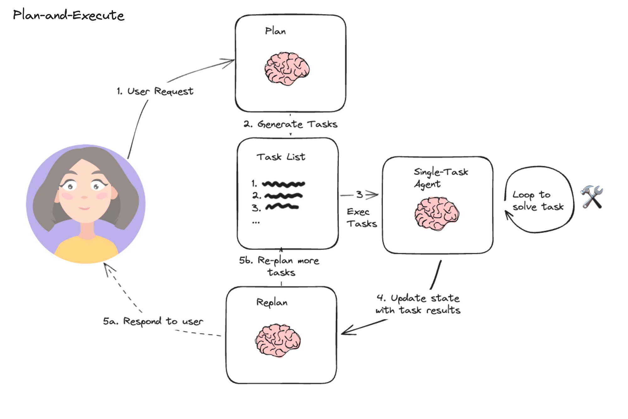
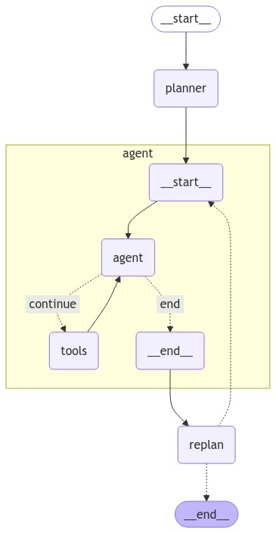
Programming agentic flows with graphs
From: https://langchain-ai.github.io/langgraph/tutorials/plan-and-execute/plan-and-execute/

Slide 45
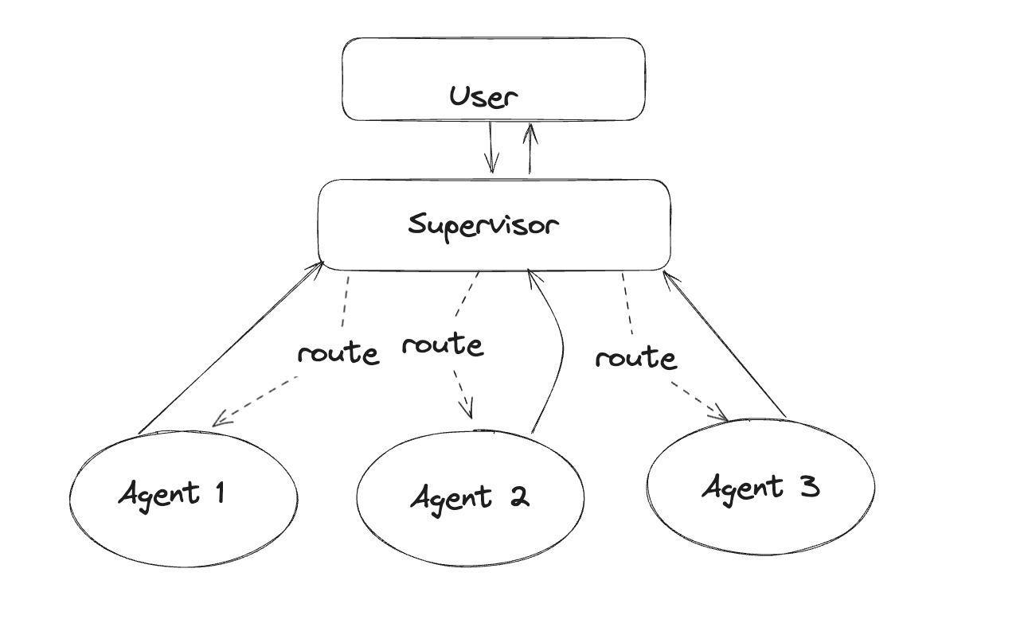
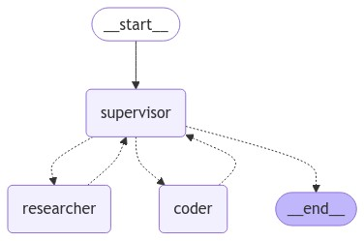
Programming agentic flows with graphs
From: https://langchain-ai.github.io/langgraph/tutorials/multi_agent/agent_supervisor/

